Slide 1
Interrupts and System Calls
Manish Shrivastava

Slide 2
Interrupt Processing
To improve the performance, interrupts are provided.
With interrupts, the processor can be engaged in executing other processes while an I/O operation is in progress.
Interrupt cycle is added to the instruction cycle.
Start
Fetch cycle
Fetch the next instruction
Execute cycle
Interrupts
Disabled
Execute the next instruction
Halt
Interrupts enables
Check for interrupt
Process Interrupt.
Interrupt cycle

Slide 3
Common Functions of Interrupts
Interrupt transfers control to the interrupt service routine generally, through the interrupt vector, which contains the addresses of all the service routines.
Interrupt architecture must save the address of the interrupted instruction.
Incoming interrupts are disabled while another interrupt is being processed to prevent a lost interrupt.
A trap is a software-generated interrupt caused either by an error or a user request.
An operating system is interrupt driven.

Slide 4
I/O Controller Interrupting
To start I/O operation, CPU loads the appropriate registers within the device controller
The device controller examines the contents of these registers to determine what action to take.
If it s a read operation the controller transfers the data into local buffer.
Then it informs the CPU through interrupt.
The operating system preserves the state of the CPU by storing registers and the program counter.

Slide 5
Interrupt Handling
Interrupt handler: The CPU hardware has a wire called interrupt request line; that CPU senses after executing every instruction.
When a CPU senses a signal, it saves the PC, and PSW on a stack and jump to the interrupt handler routine at a fixed address in memory.
Interrupt vector: It contains the memory addresses of specialized interrupt handlers.

Slide 6
Interrupt Handling
Interrupts allow devices to notify the CPU when they have data to transfer or when an operation is complete, allowing the CPU to perform other duties when no I/O transfers need its immediate attention.
The CPU has an interrupt-request line that is sensed after every instruction.
A device's controller raises an interrupt by asserting a signal on the interrupt request line.
The CPU then performs a state save, and transfers control to the interrupt handler routine at a fixed address in memory. ( The CPU catches the interrupt and dispatches the interrupt handler. )
The interrupt handler determines the cause of the interrupt, performs the necessary processing, performs a state restore, and executes a return from interrupt instruction to return control to the CPU. ( The interrupt handler clears the interrupt by servicing the device. )
( Note that the state restored does not need to be the same state as the one that was saved when the interrupt went off. )

Slide 7
I/O Structure
Synchronous I/O: After I/O starts, control returns to user program only upon I/O completion.
Wait instruction idles the CPU until the next interrupt
At most one I/O request is outstanding at a time, no simultaneous I/O processing.
Asynchronous I/O: After I/O starts, control returns to user program without waiting for I/O completion.
non-blocking I/O: the I/O request returns immediately, whether the requested I/O operation has ( completely ) occurred or not
Device-status table contains entry for each I/O device indicating its type, address, and state.
Operating system indexes into I/O device-status table to determine device status and to modify table entry.

Slide 8
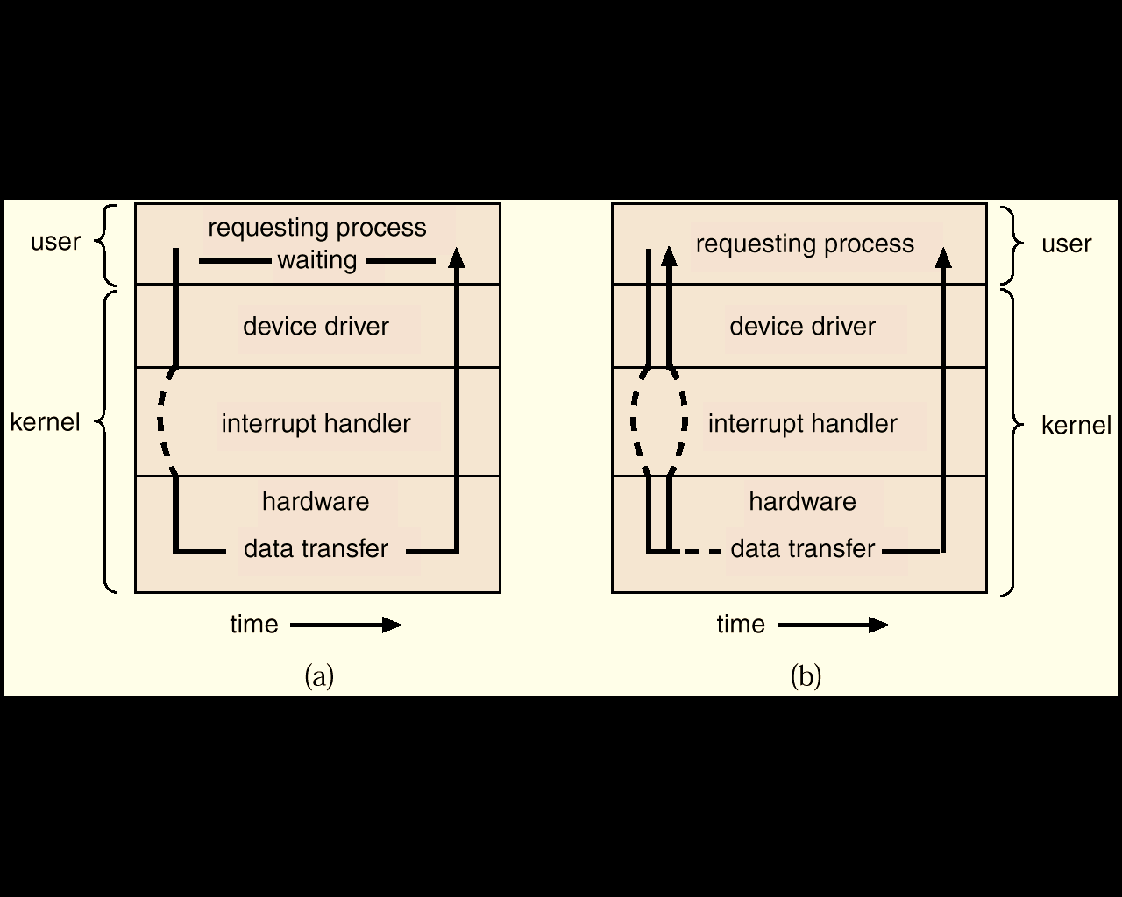
Two I/O Methods
Synchronous
Asynchronous

Slide 9
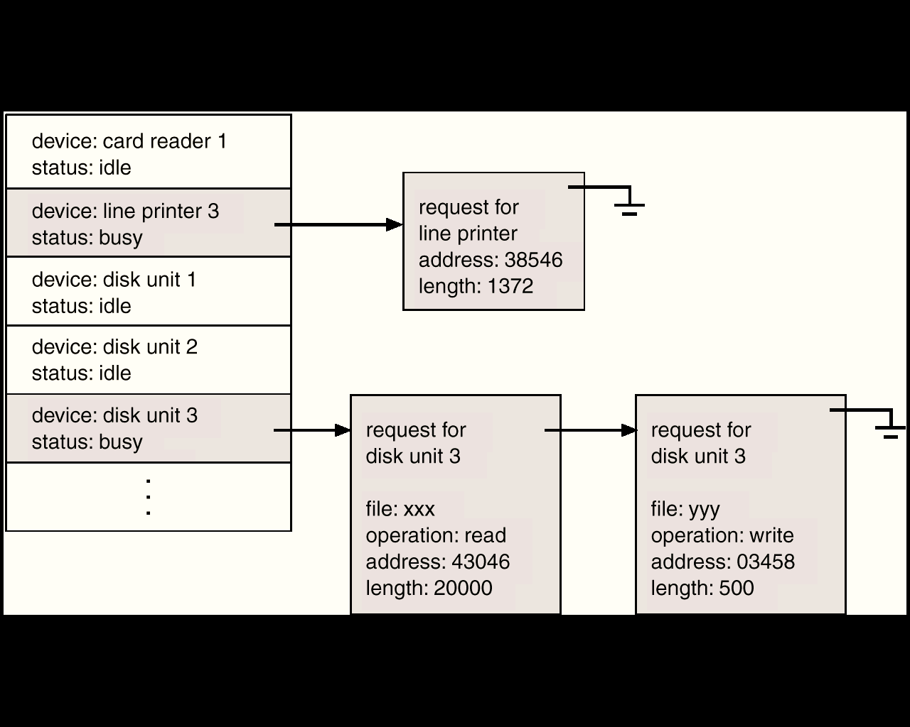
Device-Status Table

Slide 10
I/O communication techniques
Two kinds of data transfer
Program data transfer: CPU checks the I/O status
The I/O module does not interrupt the processor.
Processor is responsible for extracting the data from main memory and shifting data out of main memory.
It is a time-consuming process that keeps the processor busy unnecessarily.
Interrupt driven data transfer: when I/O is ready it interrupts the CPU
In Interrupt driven data transfer, the I/O module will interrupt the processor to request service when it is ready to exchange data with the processor.

Slide 11
Modern Computer
The above description is adequate for simple interrupt-driven I/O, but there are three needs in modern computing which complicate the picture:
The need to defer interrupt handling during critical processing,
The need to determine which interrupt handler to invoke, without having to poll all devices to see which one needs attention, and
The need for multi-level interrupts, so the system can differentiate between high- and low-priority interrupts for proper response.

Slide 12
Interrupt Controller
These issues are handled in modern computer architectures with interrupt-controller hardware.
Most CPUs now have two interrupt-request lines: One that is non-maskable for critical error conditions and one that is maskable, that the CPU can temporarily ignore during critical processing.
The interrupt mechanism accepts an address, which is usually one of a small set of numbers for an offset into a table called the interrupt vector. This table holds the addresses of routines prepared to process specific interrupts.
The number of possible interrupt handlers still exceeds the range of defined interrupt numbers, so multiple handlers can be interrupt chained. Effectively the addresses held in the interrupt vectors are the head pointers for linked-lists of interrupt handlers.
Modern interrupt hardware also supports interrupt priority levels, allowing systems to mask off only lower-priority interrupts while servicing a high-priority interrupt, or conversely to allow a high-priority signal to interrupt the processing of a low-priority one.

Slide 13
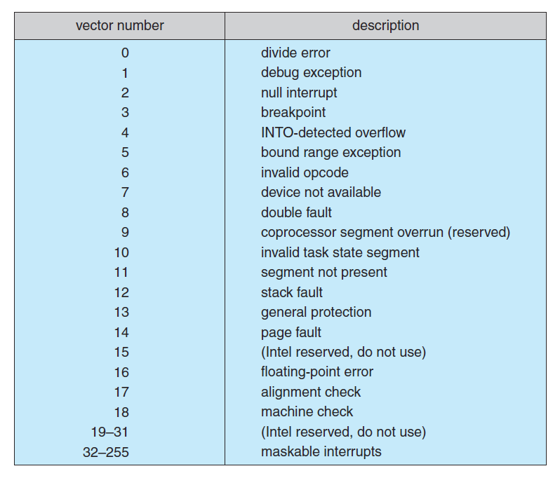
Interrupt Vector Table

Slide 14
Interrupt Controller
At boot time the system determines which devices are present, and loads the appropriate handler addresses into the interrupt table.
During operation, devices signal errors or the completion of commands via interrupts.
Exceptions, such as dividing by zero, invalid memory accesses, or attempts to access kernel mode instructions can be signaled via interrupts.
Time slicing and context switches can also be implemented using the interrupt mechanism.
The scheduler sets a hardware timer before transferring control over to a user process.
When the timer raises the interrupt request line, the CPU performs a state-save, and transfers control over to the proper interrupt handler, which in turn runs the scheduler.
The scheduler does a state-restore of a different process before resetting the timer and issuing the return-from-interrupt instruction.

Slide 15
Some Interrupts
A similar example involves the paging system for virtual memory –
A page fault causes an interrupt, which in turn issues an I/O request and a context switch, moving the interrupted process into the wait queue and selecting a different process to run. When the I/O request has completed then the device interrupts, and the interrupt handler moves the process from the wait queue into the ready queue.
Some OSs (Solaris OS) use a multi-threaded kernel and priority threads to assign different threads to different interrupt handlers. This allows for the "simultaneous" handling of multiple interrupts, and the assurance that high-priority interrupts will take precedence over low-priority ones and over user processes.

Slide 16
Some Interrupts
System calls are implemented via software interrupts, a.k.a. traps. When a (library) program needs work performed in kernel mode, it sets command information and possibly data addresses in certain registers, and then raises a software interrupt.
The completion of a disk read operation involves two interrupts:
A high-priority interrupt acknowledges the device completion, and issues the next disk request so that the hardware does not sit idle.
A lower-priority interrupt transfers the data from the kernel memory space to the user space, and then transfers the process from the waiting queue to the ready queue.

Slide 17
Direct Memory Access
For devices that transfer large quantities of data (such as disk controllers), it is wasteful to tie up the CPU transferring data in and out of registers one byte at a time
Instead this work can be off-loaded to a special processor, known as the Direct Memory Access, DMA, Controller.
The host issues a command to the DMA controller, indicating the details of transfer operation. The DMA interrupts the CPU when the transfer is complete.
A simple DMA controller is a standard component in modern PCs, and many bus-mastering I/O cards contain their own DMA hardware.
Handshaking between DMA controllers and their devices is accomplished through two wires called the DMA-request and DMA-acknowledge wires.
While the DMA transfer is going on the CPU does not have access to the PCI bus (including main memory), but it does have access to its internal registers and primary and secondary caches.

Slide 18
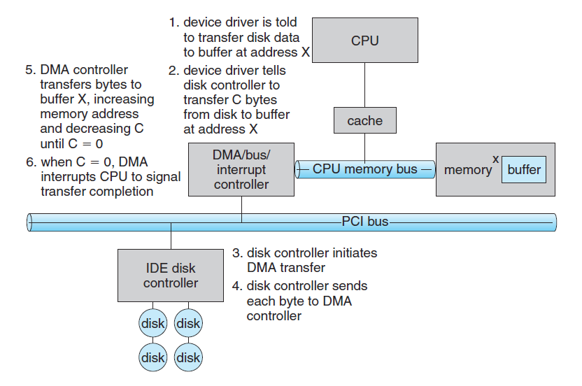
Direct Memory Access

Slide 19
Direct Memory Access
DMA can be done in terms of either physical addresses or virtual addresses that are mapped to physical addresses. The latter approach is known as Direct Virtual Memory Access, DVMA, and allows direct data transfer from one memory-mapped device to another without using the main memory chips.
Direct DMA access by user processes can speed up operations, but is generally forbidden by modern systems for security and protection reasons.

Slide 20
System Calls
The system calls are the instruction set of the OS virtual processor.
Programming interface to the services provided by the OS.
Typically written in a high-level language (C or C++).
Mostly accessed by programs via a high-level Application Program Interface (API) rather than direct system call use.
Three most common APIs are Win32 API for Windows, *POSIX API for POSIX-based systems (including virtually all versions of UNIX, Linux, and Mac OS X), and Java API for the Java virtual machine (JVM).
*Portable Operating System Interface (POSIX)

Slide 21
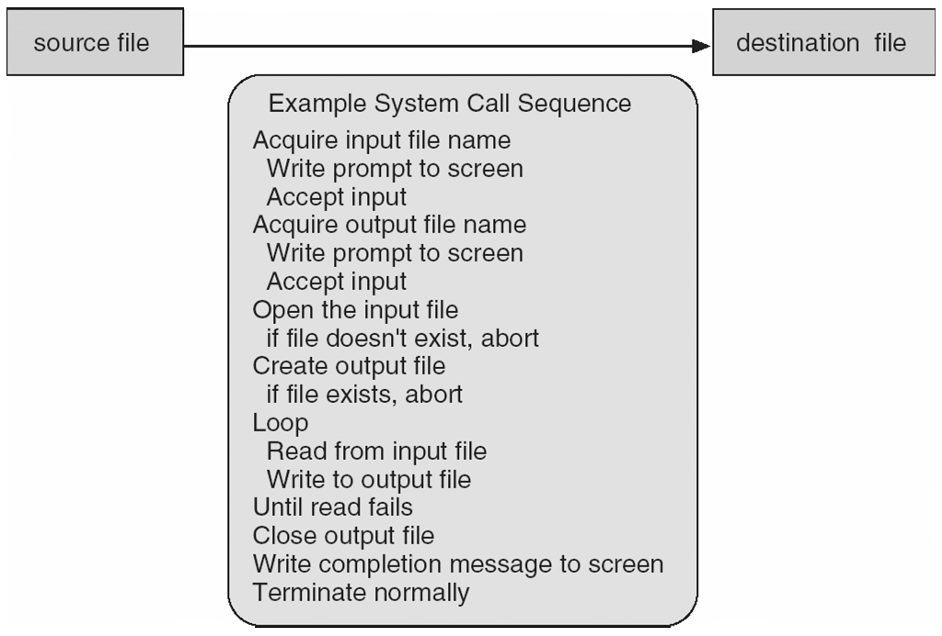
Example of System Calls
System call sequence to copy the contents of one file to another file

Slide 22
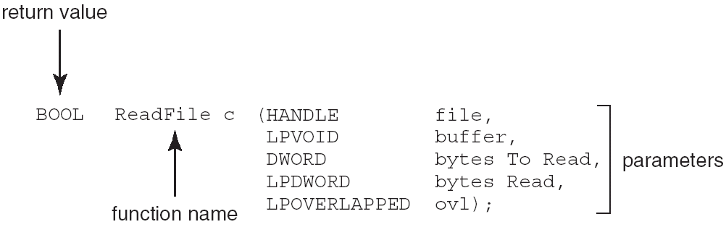
Example of Standard API
Consider the ReadFile() function in the Win32 API—a function for reading from a file
A description of the parameters passed to ReadFile()
HANDLE file—the file to be read
LPVOID buffer—a buffer where the data will be read into and written from
DWORD bytesToRead—the number of bytes to be read into the buffer
LPDWORD bytesRead—the number of bytes read during the last read
LPOVERLAPPED ovl—indicates if overlapped I/O is being used
Notes:
Overlapped I/O is an asynchronous I/O extension of the Windows APIs, which was introduced in Windows NT.

Slide 23
System Call Implementation
Typically, a number associated with each system call
System-call interface maintains a table indexed according to these numbers
The system call interface invokes intended system call in OS kernel and returns status of the system call and any return values
The caller need know nothing about how the system call is implemented
Just needs to obey API and understand what OS will do as a result call
Most details of OS interface hidden from programmer by API
Managed by run-time support library (set of functions built into libraries included with compiler)

Slide 24
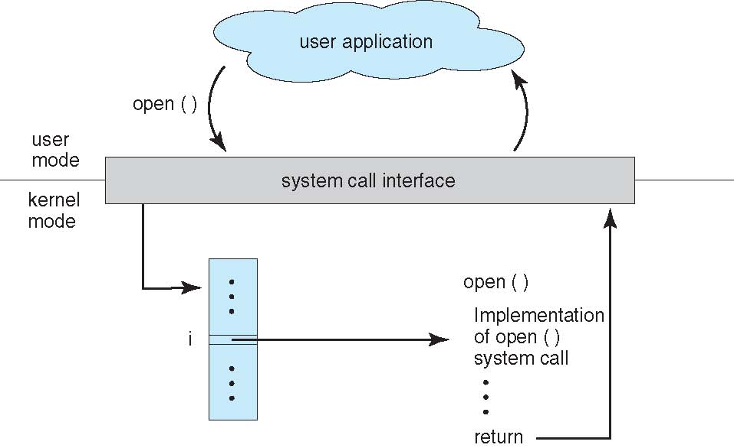
API – System Call – OS Relationship

Slide 25
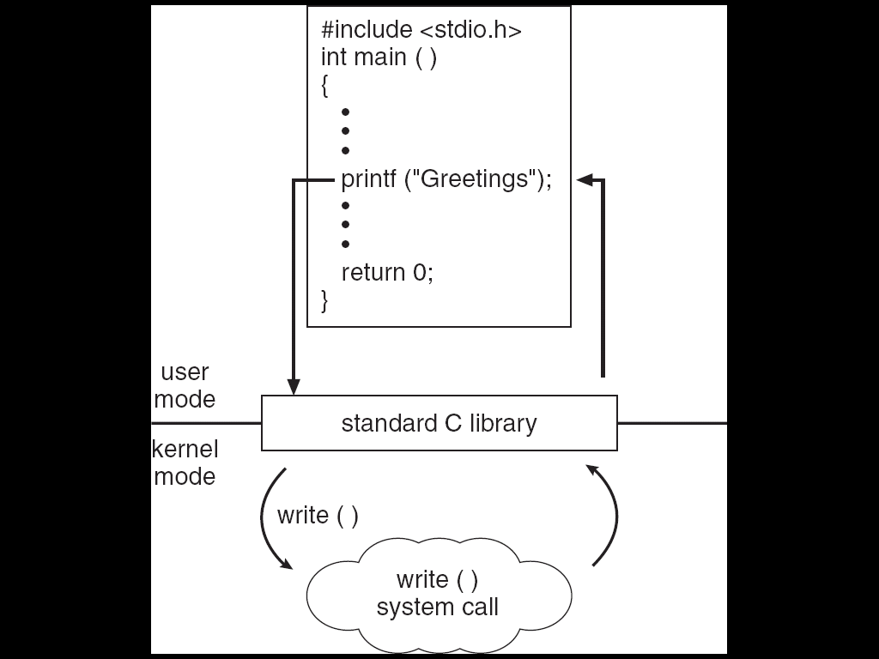
Standard C Library Example
C program invoking printf() library call, which calls write() system call

Slide 26
System Call Parameter Passing
Often, more information is required than simply identity of desired system call
Exact type and amount of information vary according to OS and call
Three general methods used to pass parameters to the OS
Simplest: pass the parameters in registers
In some cases, may be more parameters than registers
Parameters stored in a block, or table, in memory, and address of block passed as a parameter in a register
This approach taken by Linux and Solaris
Parameters placed, or pushed, onto the stack by the program and popped off the stack by the operating system
Block and stack methods do not limit the number or length of parameters being passed

Slide 27
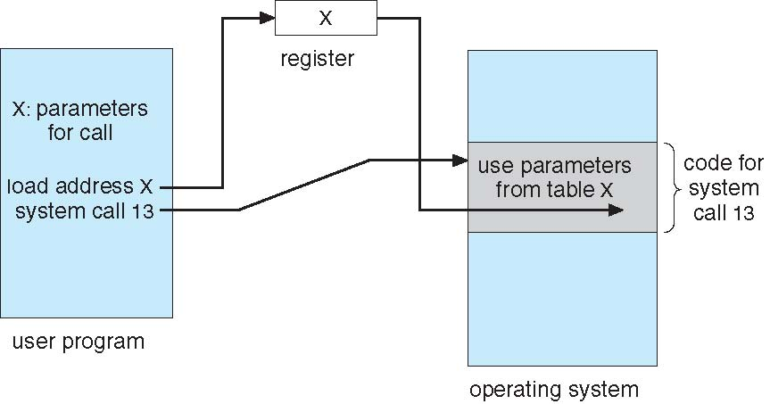
Parameter Passing via Table

Slide 28
Types of System Calls
Process control
end, abort
load, execute
create process, terminate process
get process attributes, set process attributes
wait for time
wait event, signal event
allocate and free memory
File management
create file, delete file
open, close file
read, write, reposition
get and set file attributes

Slide 29
Types of System Calls
Device management
request device, release device
read, write, reposition
get device attributes, set device attributes
logically attach or detach devices
Information maintenance
get time or date, set time or date
get system data, set system data
get and set process, file, or device attributes
Communications
create, delete communication connection
send, receive messages
transfer status information
attach and detach remote devices

Slide 30
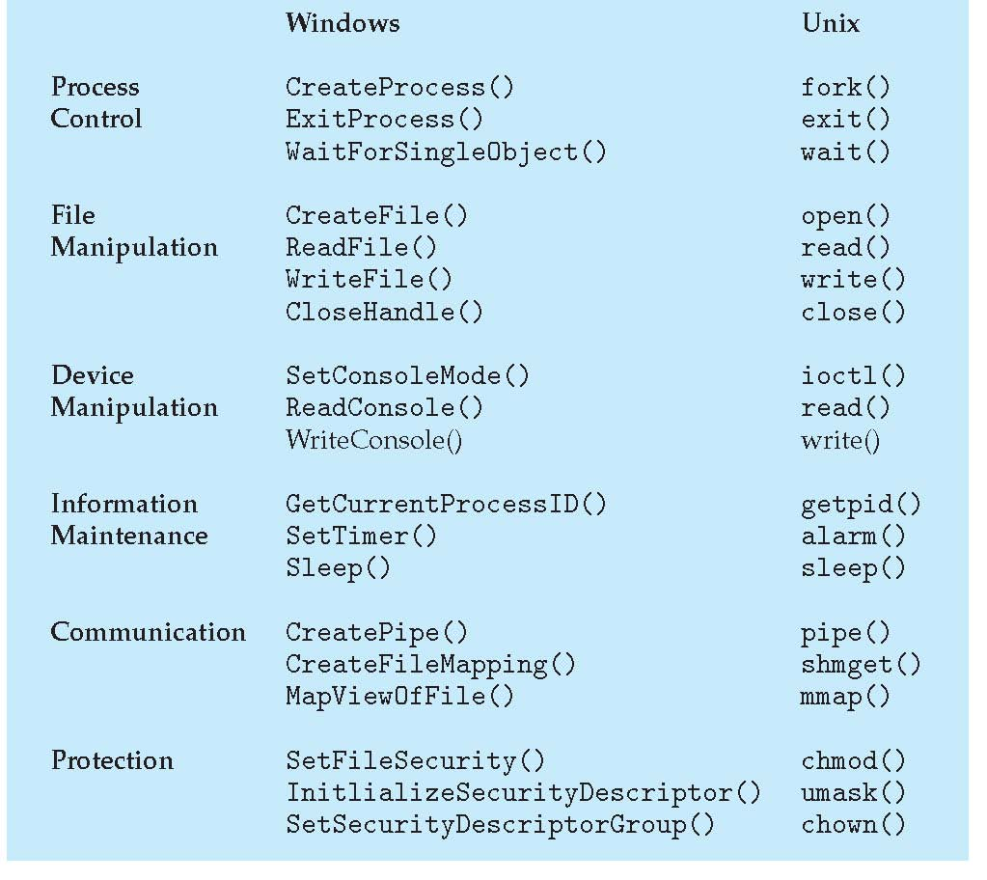
Examples of Windows and Unix System Calls

Slide 31
Types of System Calls: Process Control Example: MS-DOS
Single-tasking
Shell invoked when system booted
Simple method to run program
No process created
Single memory space
Loads program into memory, overwriting all but the kernel
Program exit -> shell reloaded

Slide 32
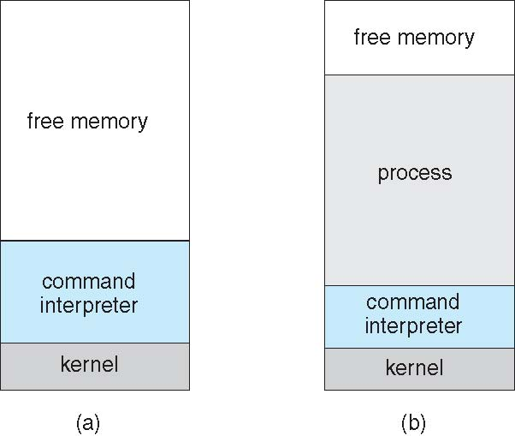
MS-DOS execution

Slide 33
Process Control Example: FreeBSD
Unix variant
Multitasking
User login -> invoke user’s choice of shell
Shell executes fork() system call to create process
Executes exec() to load program into process
Shell waits for process to terminate or continues with user commands
Process exits with code of 0 – no error or > 0 – error code

Slide 34
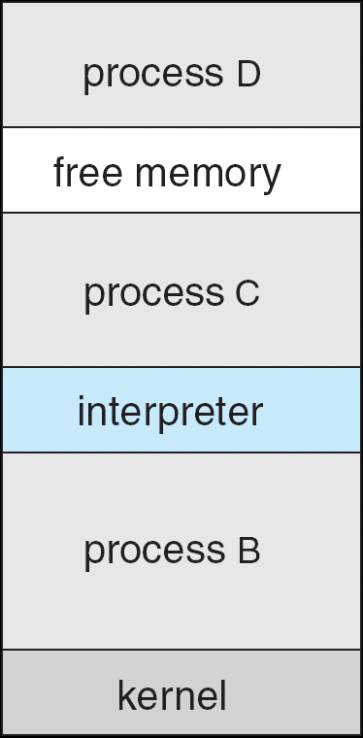
FreeBSD Running Multiple Programs

Slide 35
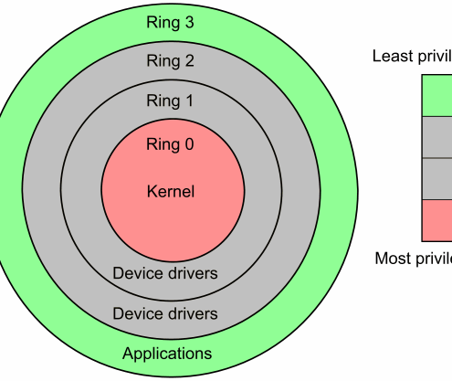
Linux system calls
Operating systems offer processes running in User Mode a set of interfaces to interact with hardware devices such as
the CPU
disks
printers.
Unix systems implement most interfaces between User Mode processes and hardware devices by means of system calls issued to the kernel.

Slide 36
POSIX APIs vs. System Calls
An application programmer interface (API) is a function definition that specifies how to obtain a given service.
A system call is an explicit request to the kernel made via a software interrupt.

Slide 37
From a Wrapper Routine to a System Call
Unix systems include several libraries of functions that provide APIs to programmers.
Some of the APIs defined by the libc standard C library refer to wrapper routines (routines whose only purpose is to issue a system call).
Usually, each system call has a corresponding wrapper routine, which defines the API that application programs should employ.

Slide 38
APIs and System Calls
An API does not necessarily correspond to a specific system call.
First of all, the API could offer its services directly in User Mode. (For something abstract such as math functions, there may be no reason to make system calls.)
Second, a single API function could make several system calls.
Moreover, several API functions could make the same system call, but wrap extra functionality around it.

Slide 39
Example of Different APIs Issuing the Same System Call
In Linux, the malloc( ), calloc( ), and free( ) APIs are implemented in the libc library.
The code in this library keeps track of the allocation and deallocation requests and uses the brk( ) system call to enlarge or shrink the process heap.
Linux defines a set of seven macros called _syscall0 through _syscall6.
Example: _syscall3(int,write,int,fd,const char *,buf,unsigned int,count)

Slide 40
The Return Value of a Wrapper Routine
Most wrapper routines return an integer value, whose meaning depends on the corresponding system call.
A return value of -1 usually indicates that the kernel was unable to satisfy the process request.
A failure in the system call handler may be caused by
invalid parameters
a lack of available resources
hardware problems, and so on.
The specific error code is contained in the errno variable, which is defined in the libc library.

Slide 41
Execution Flow of a System Call
When a User Mode process invokes a system call, the CPU switches to Kernel Mode and starts the execution of a kernel function.
As we will see in the next section, in the 80x86 architecture a Linux system call can be invoked in two different ways.
The net result of both methods, however, is a jump to an assembly language function called the system call handler.

Slide 42
System Call Number
Because the kernel implements many different system calls, the User Mode process must pass a parameter called the system call number to identify the required system call.
The eax register is used by Linux for this purpose.
Additional parameters are usually passed when invoking a system call.

Slide 43
The Return Value of a System Call
All system calls return an integer value.
The conventions for these return values are different from those for wrapper routines. In the kernel:
positive or 0 values denote a successful termination of the system call
negative values denote an error condition
In the latter case, the value is the negation of the error code that must be returned to the application program in the errno variable.
The errno variable is not set or used by the kernel. Instead, the wrapper routines handle the task of setting this variable after a return from a system call.

Slide 44
Operations Performed by a System Call
The system call handler, which has a structure similar to that of the other exception handlers, performs the following operations:
*Saves the contents of most registers in the Kernel Mode stack.
Handles the system call by invoking a corresponding C function called the system call service routine.
*Exits from the handler:
the registers are loaded with the values saved in the Kernel Mode stack
the CPU is switched back from Kernel Mode to User Mode.
*This operation is common to all system calls and is coded in assembly language.

Slide 45
Naming Rules of System Call Service Routines
The name of the service routine associated with the xyz( ) system call is usually sys_xyz( ); there are, however, a few exceptions to this rule.

Slide 46
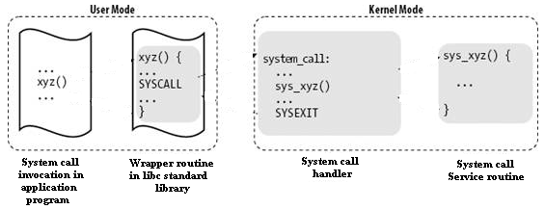
Control Flow Diagram of a System Call
The arrows denote the execution flow between the functions.
The terms "SYSCALL" and "SYSEXIT" are placeholders for the actual assembly language instructions that switch the CPU, respectively, from User Mode to Kernel Mode and from Kernel Mode to User Mode.

Slide 47
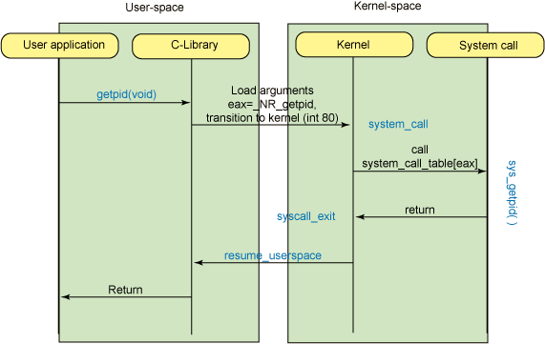
Control Flow Diagram of a System Call

Slide 48
Process Related System Calls
The UNIX system provides several system calls to
create and end program,
to send and receive software interrupts,
to allocate memory, and to do other useful jobs for a process.
Four system calls are provided for creating a process, ending a process, and waiting for a process to complete.
These system calls are fork(), the "exec" family, wait(), and exit().

Slide 49
exec() system calls
The UNIX system calls that transform a executable binary file into a process are the "exec" family of system calls. The prototypes for these calls are:
int execl(file_name, arg0 [, arg1, ..., argn], NULL)
char *file_name, *arg0, *arg1, ..., *argn;
int execv(file_name, argv)
char *file_name, *argv[];
int execle(file_name, arg0 [, arg1, ..., argn], NULL, envp)
char *file_name, *arg0, *arg1, ..., *argn, *envp[];
int execve(file_name, argv, envp)
char *file_name, *argv[], *envp[];
int execlp(file_name, arg0 [, arg1, ..., argn], NULL)
char *file_name, *arg0, *arg1, ..., *argn;
int execvp(file_name, argv)
char *file_name, *argv[];

Slide 50
exec() system calls (Cont’d)
Unlike the other system calls and subroutines, a successful exec system call does not return. Instead, control is given to the executable binary file named as the first argument.
When that file is made into a process, that process replaces the process that executed the exec system call -- a new process is not created.

Slide 51
exec() system calls (Cont’d)
Letters added to the end of exec indicate the type of arguments:
l argn is specified as a list of arguments.
v argv is specified as a vector (array of character pointers).
e environment is specified as an array of character pointers.
p user's PATH is searched for command, and command can be a shell program

Slide 52
fork() system call
To create a new process, you must use the fork() system call.
The prototype for
the fork() system call is:
int fork()
fork() causes the UNIX system to create a new process, called the "child process", with a new process ID. The contents of the child process are identical to the contents of the parent process.

Slide 53
fork() system call (Cont’d)
The new process inherits several characteristics of the old process. Among the characteristics inherited are:
The environment.
All signal settings.
The set user ID and set group ID status.
The time left until an alarm clock signal.
The current working directory and the root directory.
The file creation mask as established with umask().
fork() returns zero in the child process and non-zero (the child's process ID) in the parent process.

Slide 54
wait() system call
You can control the execution of child processes by calling wait() in the parent.
wait() forces the parent to suspend execution until the child is finished.
wait() returns the process ID of a child process that finished.
If the child finishes before the parent gets around to calling wait(), then when wait() is called by the parent, it will return immediately with the child's process ID.

Slide 55
wait() system call (Cont’d)
The prototype for the wait() system call is:
int wait(status)
int *status;
“status” is a pointer to an integer where the UNIX system stores the value returned by the child process. wait() returns the process ID of the process that ended.

Slide 56
exit() system call
The exit() system call ends a process and returns a value to it parent.
The prototype for the exit() system call is:
void exit(status)
int status;
where status is an integer between 0 and 255. This number is returned to the parent via wait() as the exit status of the process.
By convention, when a process exits with a status of zero that means it didn't encounter any problems; when a process exit with a non-zero status that means it did have problems.

Slide 57
Software Interrupt
The UNIX system provides a facility for sending and receiving software interrupts, also called SIGNALS.
Signals are sent to a process when a predefined condition happens.
The number of signals available is system dependent.
The signal name is defined in /usr/include/sys/signal.h as a manifest constant.

Slide 58
Signal
Programs can respond to signals three different ways.
Ignore the signal. This means that the program will never be informed of the signal no matter how many times it occurs. The only exception to this is the SIGKILL signal which can neither be ignored nor caught.
A signal can be set to its default state, which means that the process will be ended when it receives that signal. In addition, if the process receives any of SIGQUIT, SIGILL, SIGIOT, SIGEMT, SIGFPE, SIGBUS, SIGSEGV, or SIGSYS, the UNIX system will produce a core image (core dump), if possible, in the directory where the process was executing when it received the program-ending signal.
Catch the signal. When the signal occurs, the UNIX system will transfer control to a previously defined subroutine where it can respond to the signal as is appropriate for the program.

Slide 59
Signal
Related system calls
signal
kill
alarm

Slide 60
signal() system call
You define how you want to respond to a signal with the signal() system call. The prototype is:
#include <sys/signal.h>
int (* signal ( signal_name, function ))
int signal_name;
int (* function)();

Slide 61
kill() system call
The UNIX system sends a signal to a process when something happens, such as typing the interrupt key on a terminal, or attempting to execute an illegal instruction. Signals are also sent to a process with the kill() system call. Its prototype is:
int kill (process_id, signal_name )
int process_it, signal_name;

Slide 62
alarm() system call
Every process has an alarm clock stored in its system-data segment. When the alarm goes off, signal SIGALRM is sent to the calling process. A child inherits its parent's alarm clock value, but the actual clock isn't shared.
The alarm clock remains set across an exec. The prototype for alarm() is:
unsigned int alarm(seconds)
unsigned int seconds;
Check
timesup.c

Slide 63
Examples : File Creation
/* creat.c */
#include <stdio.h>
#include <sys/types.h> /* defines types used by sys/stat.h */
#include <sys/stat.h> /* defines S_IREAD & S_IWRITE */
int main() {
int fd;
fd = creat("datafile.dat", S_IREAD | S_IWRITE);
if (fd == -1)
printf("Error in opening datafile.dat\n");
else {
printf("datafile.dat opened for read/write access\n");
printf("datafile.dat is currently empty\n");
}
close(fd);
exit (0);
}

Slide 64
Stat.h
#define S_IRWXU 0000700 /* -rwx------ */
#define S_IREAD 0000400 /* read permission, owner */
#define S_IRUSR S_IREAD
#define S_IWRITE 0000200 /* write permission, owner */
#define S_IWUSR S_IWRITE
#define S_IEXEC 0000100 /* execute/search permission, owner */
#define S_IXUSR S_IEXEC
#define S_IRWXG 0000070 /* ----rwx--- */
#define S_IRGRP 0000040 /* read permission, group */
#define S_IWGRP 0000020 /* write " " */
#define S_IXGRP 0000010 /* execute/search " " */
#define S_IRWXO 0000007 /* -------rwx */
#define S_IROTH 0000004 /* read permission, other */
#define S_IWOTH 0000002 /* write " " */
#define S_IXOTH 0000001 /* execute/search " " */

Slide 65
File Open
/* open.c */
#include <fcntl.h> /* defines options flags */
#include <sys/types.h> /* defines types used by sys/stat.h */
#include <sys/stat.h> /* defines S_IREAD & S_IWRITE */
static char message[] = "Hello, world";
int main() {
int fd; char buffer[80];
fd = open("datafile.dat",O_RDWR | O_CREAT | O_EXCL, S_IREAD | S_IWRITE);
if (fd != -1) {
printf("datafile.dat opened for read/write access\n");
write(fd, message, sizeof(message));
lseek(fd, 0L, 0); /* go back to the beginning of the file */
if (read(fd, buffer, sizeof(message)) == sizeof(message))
printf("\"%s\" was written to datafile.dat\n", buffer);
else
printf("*** error reading datafile.dat ***\n");
close (fd);
} else printf("*** datafile.dat already exists ***\n");
exit (0);
}

